Slide 1
IoT시스템
4주차 과제
반 YA 학번: 20202296
이름: 전채린

Slide 2
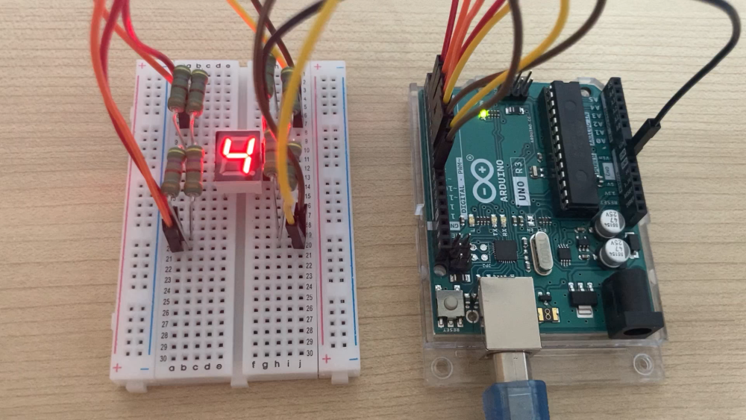
실습1 동작 영상

Slide 3
실습1 스케치
const int _a=2;
const int _b=3;
const int _c=4;
const int _d=5;
const int _e=9;
const int _f=8;
const int _g=7;
const int _dot=6;
void display_number(int n) {
switch(n)
{
case 0:
digitalWrite(_e, HIGH);
digitalWrite(_b, HIGH);
digitalWrite(_c, HIGH);
digitalWrite(_d, HIGH);
digitalWrite(_g, HIGH);
digitalWrite(_f, HIGH);
digitalWrite(_a, LOW);
digitalWrite(_dot, LOW);
break;
case 1:
digitalWrite(_e, LOW);
digitalWrite(_b, LOW);
digitalWrite(_c, LOW);
digitalWrite(_d, LOW);
digitalWrite(_g, HIGH);
digitalWrite(_f, HIGH);
digitalWrite(_a, LOW);
digitalWrite(_dot, LOW);
break;
case 2:
digitalWrite(_e, HIGH);
digitalWrite(_b, LOW);
digitalWrite(_c, HIGH);
digitalWrite(_d, HIGH);
digitalWrite(_g, LOW);
digitalWrite(_f, HIGH);
digitalWrite(_a, HIGH);
digitalWrite(_dot, LOW);
break;
case 3:
digitalWrite(_e, HIGH);
digitalWrite(_b, LOW);
digitalWrite(_c, LOW);
digitalWrite(_d, HIGH);
digitalWrite(_g, HIGH);
digitalWrite(_f, HIGH);
digitalWrite(_a, HIGH);
digitalWrite(_dot, LOW);
break;
case 4:
digitalWrite(_e, LOW);
digitalWrite(_b, HIGH);
digitalWrite(_c, LOW);
digitalWrite(_d, LOW);
digitalWrite(_g, HIGH);
digitalWrite(_f, HIGH);
digitalWrite(_a, HIGH);
digitalWrite(_dot, LOW);
break;
}}
case 5:
digitalWrite(_e, HIGH);
digitalWrite(_b, HIGH);
digitalWrite(_c, LOW);
digitalWrite(_d, HIGH);
digitalWrite(_g, HIGH);
digitalWrite(_f, LOW);
digitalWrite(_a, HIGH);
digitalWrite(_dot, LOW);
break;
case 6:
digitalWrite(_e, HIGH);
digitalWrite(_b, HIGH);
digitalWrite(_c, HIGH);
digitalWrite(_d, HIGH);
digitalWrite(_g, HIGH);
digitalWrite(_f, LOW);
digitalWrite(_a, HIGH);
digitalWrite(_dot, LOW);
break;

Slide 4
실습1 스케치
case 7:
digitalWrite(_e, HIGH);
digitalWrite(_b, HIGH);
digitalWrite(_c, LOW);
digitalWrite(_d, LOW);
digitalWrite(_g, HIGH);
digitalWrite(_f, HIGH);
digitalWrite(_a, LOW);
digitalWrite(_dot, LOW);
break;
case 8:
digitalWrite(_e, HIGH);
digitalWrite(_b, HIGH);
digitalWrite(_c, HIGH);
digitalWrite(_d, HIGH);
digitalWrite(_g, HIGH);
digitalWrite(_f, HIGH);
digitalWrite(_a, HIGH);
digitalWrite(_dot, LOW);
break;
}}
case 9:
digitalWrite(_e, HIGH);
digitalWrite(_b, HIGH);
digitalWrite(_c, LOW);
digitalWrite(_d, HIGH);
digitalWrite(_g, HIGH);
digitalWrite(_f, HIGH);
digitalWrite(_a, HIGH);
digitalWrite(_dot, LOW);
break;
case 10:
digitalWrite(_e, HIGH);
digitalWrite(_b, HIGH);
digitalWrite(_c, HIGH);
digitalWrite(_d, LOW);
digitalWrite(_g, HIGH);
digitalWrite(_f, HIGH);
digitalWrite(_a, HIGH);
digitalWrite(_dot, LOW);
break;
case 11:
digitalWrite(_e, LOW);
digitalWrite(_b, HIGH);
digitalWrite(_c, HIGH);
digitalWrite(_d, HIGH);
digitalWrite(_g, HIGH);
digitalWrite(_f, LOW);
digitalWrite(_a, HIGH);
digitalWrite(_dot, LOW);
break;
case 12:
digitalWrite(_e, HIGH);
digitalWrite(_b, HIGH);
digitalWrite(_c, HIGH);
digitalWrite(_d, HIGH);
digitalWrite(_g, LOW);
digitalWrite(_f, LOW);
digitalWrite(_a, LOW);
digitalWrite(_dot, LOW);
break;
case 13:
digitalWrite(_e, LOW);
digitalWrite(_b, LOW);
digitalWrite(_c, HIGH);
digitalWrite(_d, HIGH);
digitalWrite(_g, HIGH);
digitalWrite(_f, HIGH);
digitalWrite(_a, HIGH);
digitalWrite(_dot, LOW);
break;
case 14:
digitalWrite(_e, HIGH);
digitalWrite(_b, HIGH);
digitalWrite(_c, HIGH);
digitalWrite(_d, HIGH);
digitalWrite(_g, LOW);
digitalWrite(_f, LOW);
digitalWrite(_a, HIGH);
digitalWrite(_dot, LOW);
break;
}}

Slide 5
실습1 스케치
case 15:
digitalWrite(_e, HIGH);
digitalWrite(_b, HIGH);
digitalWrite(_c, HIGH);
digitalWrite(_d, LOW);
digitalWrite(_g, LOW);
digitalWrite(_f, LOW);
digitalWrite(_a, HIGH);
digitalWrite(_dot, LOW);
break;
case 16:
digitalWrite(_e, LOW);
digitalWrite(_b, LOW);
digitalWrite(_c, LOW);
digitalWrite(_d, LOW);
digitalWrite(_g, LOW);
digitalWrite(_f, LOW);
digitalWrite(_a, LOW);
digitalWrite(_dot, HIGH);
break;
}
}
void setup() {
pinMode(_a, OUTPUT);
pinMode(_b, OUTPUT);
pinMode(_c, OUTPUT);
pinMode(_d, OUTPUT);
pinMode(_e, OUTPUT);
pinMode(_f, OUTPUT);
pinMode(_g, OUTPUT);
pinMode(_dot, OUTPUT);
}
void loop() {
int i;
for(i=0; i<17; i++)
{
display_number(i);
delay(1000);
}
}
}

Slide 6
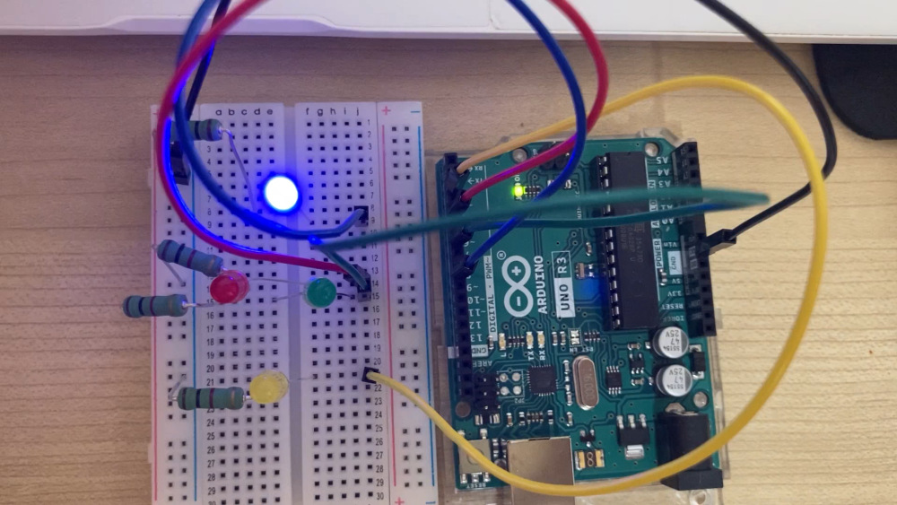
실습2 동작 영상

Slide 7
실습2 스케치
int led1 = 8;
int led2 = 4;
int led3 = 6;
int led4 = 2;
int led1_status = LOW; // LED1 상태
int led2_status = LOW; // LED2 상태
int led3_status = LOW; // LED3 상태
int led4_status = LOW; // LED4 상태
void setup() {
pinMode(led1, OUTPUT);
pinMode(led2, OUTPUT);
pinMode(led3, OUTPUT);
pinMode(led4, OUTPUT);
digitalWrite(led1, LOW);
digitalWrite(led2, LOW);
digitalWrite(led3, LOW);
digitalWrite(led4, LOW);
Serial.begin(9600);
}
void loop() {
char read_data;
if(Serial.available())
{
read_data = Serial.read();
if(read_data == '8' && led1_status == LOW)
{
digitalWrite(led1, HIGH);
led1_status = HIGH;
Serial.println("LED1 ON");
}
else if(read_data == '8' && led1_status == HIGH)
{
digitalWrite(led1, LOW);
led1_status = LOW;
Serial.println("LED1 OFF");
}
if(read_data == '4' && led2_status == LOW)
{
digitalWrite(led2, HIGH);
led2_status = HIGH;
Serial.println("LED2 ON");
}
else if(read_data == '4' && led2_status == HIGH)
{
digitalWrite(led2, LOW);
led2_status = LOW;
Serial.println("LED2 OFF");
}

Slide 8
실습2 스케치
if(read_data == '6' && led3_status == LOW)
{
digitalWrite(led3, HIGH);
led3_status = HIGH;
Serial.println("LED3 ON");
}
else if(read_data == '6' && led3_status == HIGH)
{
digitalWrite(led3, LOW);
led3_status = LOW;
Serial.println("LED3 OFF");
}
if(read_data == '2' && led4_status == LOW)
{
digitalWrite(led4, HIGH);
led4_status = HIGH;
Serial.println("LED4 ON");
}
else if(read_data == '2' && led4_status == HIGH)
{
digitalWrite(led4, LOW);
led4_status = LOW;
Serial.println("LED4 OFF");
}
if(read_data == ' ')
{
digitalWrite(led1, LOW);
digitalWrite(led2, LOW);
digitalWrite(led3, LOW);
digitalWrite(led4, LOW);
led1_status = LOW;
led2_status = LOW;
led3_status = LOW;
led4_status = LOW;
Serial.println("LED1 OFF");
Serial.println("LED2 OFF");
Serial.println("LED3 OFF");
Serial.println("LED4 OFF");
}
}
delay(10);
}

